Slide 1
Undulator Preliminary Pulsedwire

Slide 2
Keep trajectory straight…
I tuned trajectory in couple points to make straight.
Also, no reason not to adjust entrance/exit section at offsets if kick is giving too large waves on wire.
Initial post position:
X1=2.250mm
Y1=19.250mm
X2=11.150mm
Y2=9.750mm

Slide 3
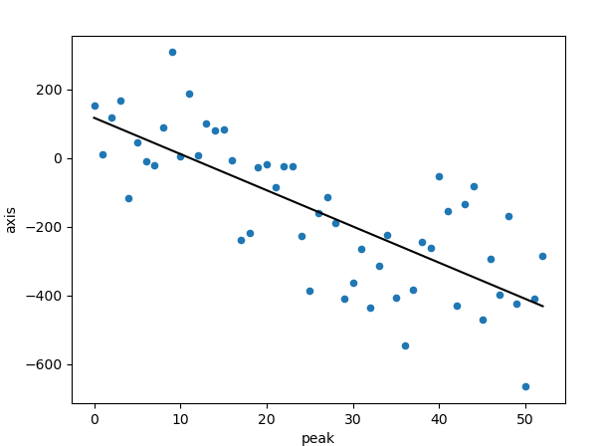
First iteration: xoffset, ytraj
Only measure -1000, 0, 1000 offsets.
Fit suggests adjustments:
Dx1 = -900
Dx2 = 550
New post positions:
X1=1.350mm
Y1=19.250mm
X2=11.700mm
Y2=9.750mm

Slide 4
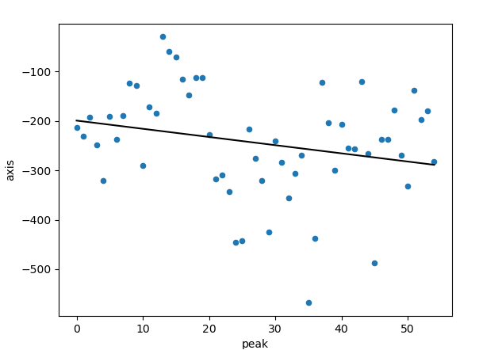
First iteration: yoffset, xtraj
Only measure -1000, 0, 1000 offsets
Fit suggests adjustments:
Dy1 = 50
Dy2 = 300
New post positions:
X1=1.350mm
Y1=19.300mm
X2=11.700mm
Y2=10.050mm

Slide 5
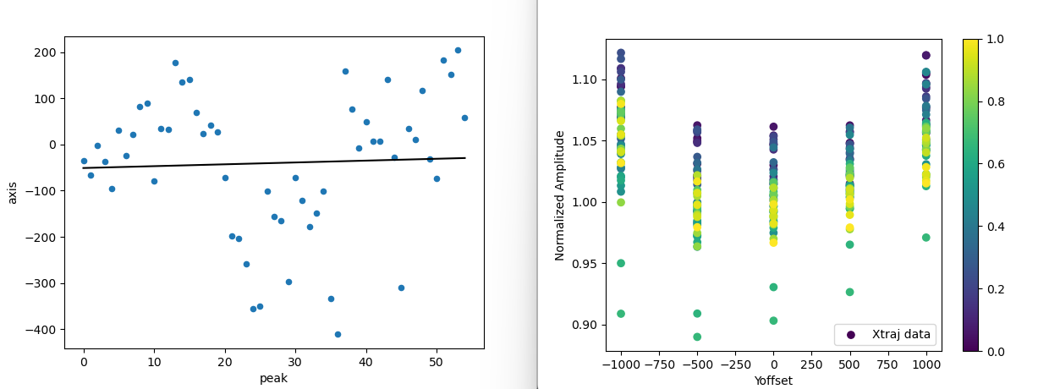
Second iteration: yoffset, xtraj
Realized I made adjustments in wrong direction (sign error).
Adjusted dy2=-1000 and now results suggest no adjustment needed.
Can see effects of sag maybe?
Measured -1000, -500, 0, 500, 1000.
I preemptively correct the sign error in xoffset as well:
Dx1 =1800
Dx2 = -1100
New post positions:
X1=3.150mm
Y1=19.300mm
X2=10.600mm
Y2=9.050mm

Slide 6
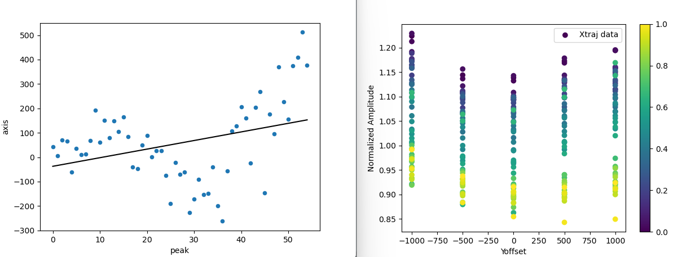
Second iteration: xoffset, ytraj
Measured -1000, -500, 0, 500, 1000.
Similar nonlinearity to yoffset, maybe this isn’t sag, just due to errors in calibration.
I only adjusted entrance angle, so trajectory became quadratic at times.
Adjustments not worth making..
Final post positions:
X1=3.150mm
Y1=19.300mm
X2=10.600mm
Y2=9.050mm

Slide 7
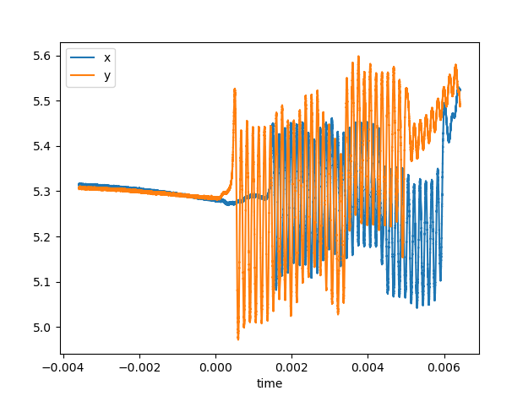
Final preliminary trajectories
text

Slide 8
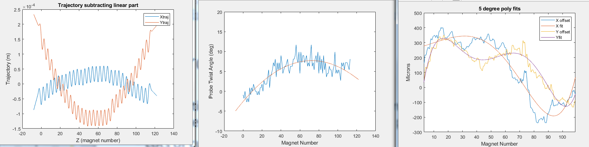
Hall Probe Measurement
Subtraction of linear trajectory component is necessary since entrance fields are not accurate with hall probe…
Lots of curvature in trajectories though…
Mostly quadratic, explained by constant offset in field?

Slide 9
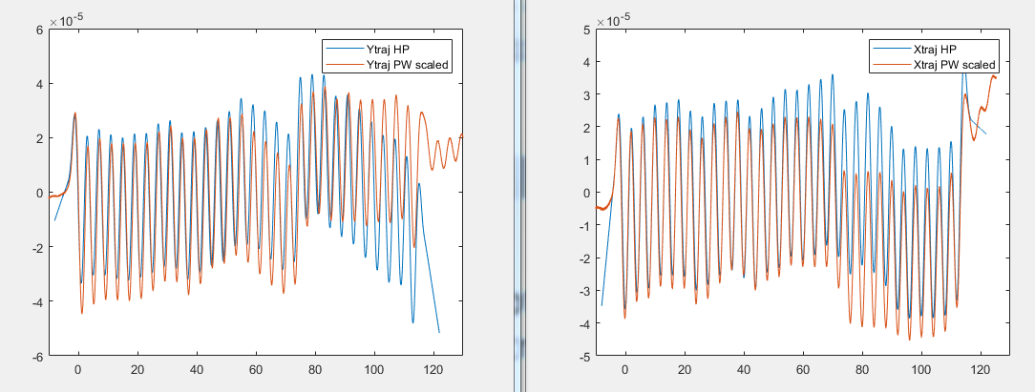
Preliminary fits
I manually define a scaling to get rough comparison.
Clearly most of error was quadratic. There is come discrepancy after the jump too.
Jump is due to magnets that were pushed in during tuning to hold vacuum pipe near axis.
By += 0.5 mT
Bx += 2 mT

Slide 10
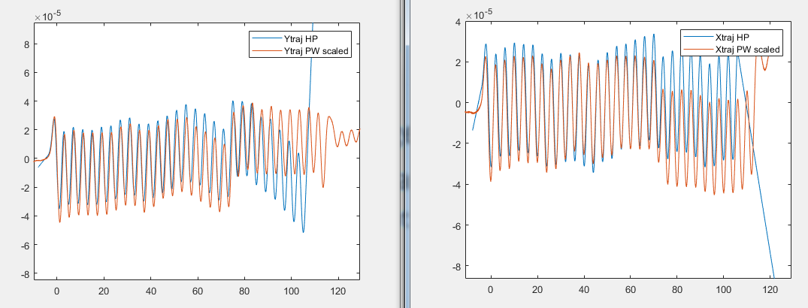
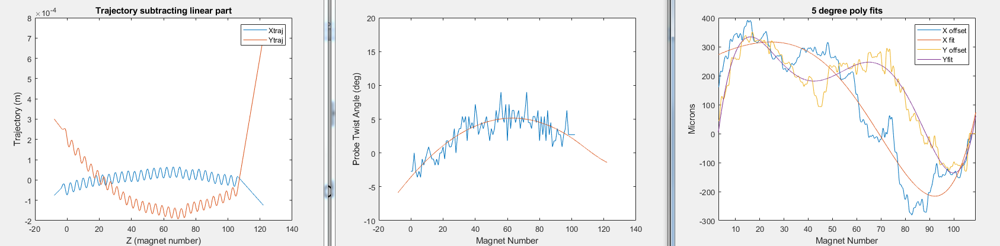
Redid Hall Probe Scan
I changed nothing for the magnets or probe setup.
Offset and twist fits are very similar.
Slight constant offset in twist. Could be due to different clamping of flatpiece?

Slide 11
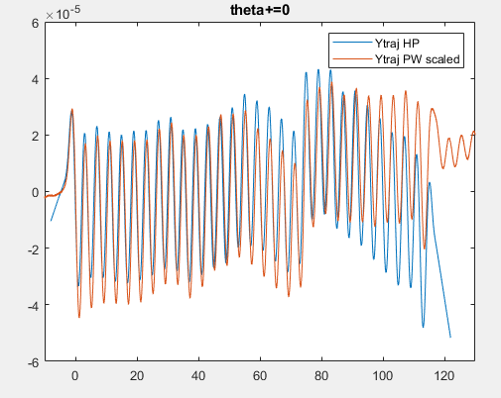
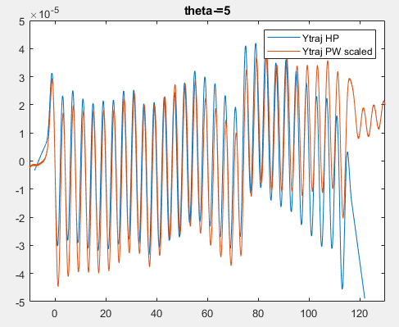
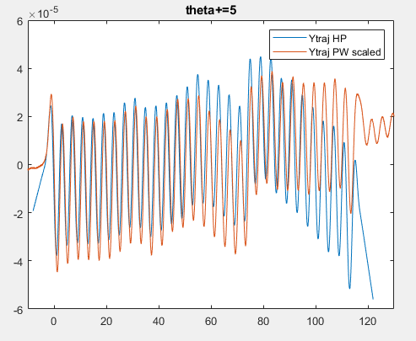
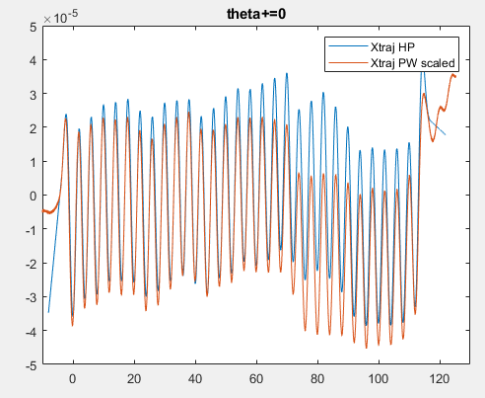
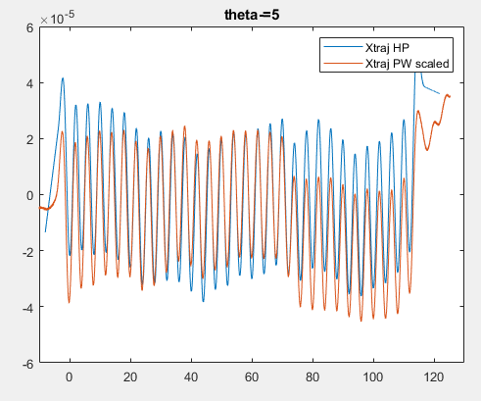
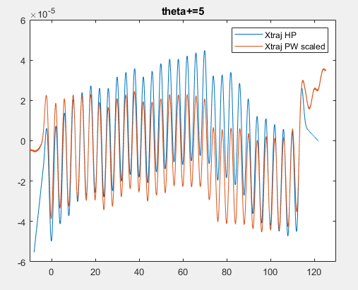
Shift in twist value?
It does affect curvature, but only in x traj?

Slide 12
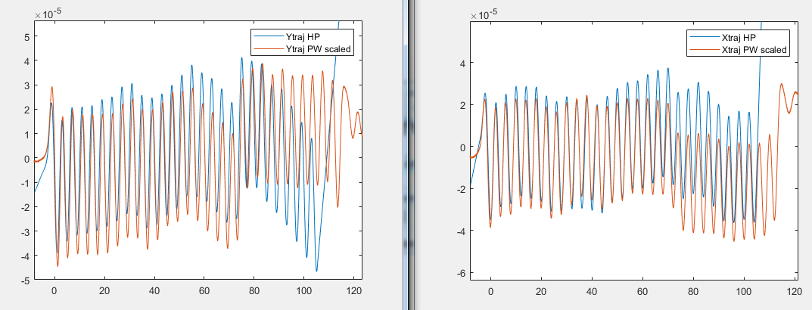
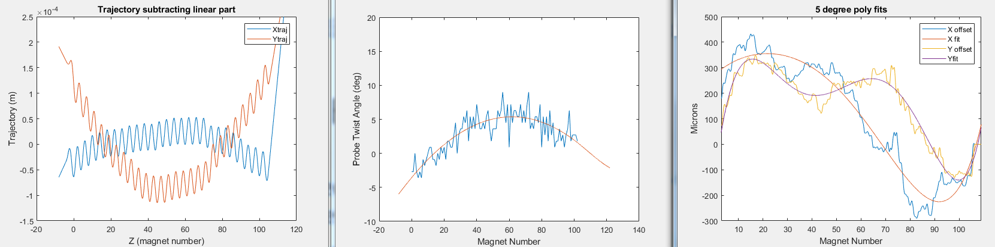
Reset Tweezers
No difference. Hall probe measurements are consistent.

